Slide 1
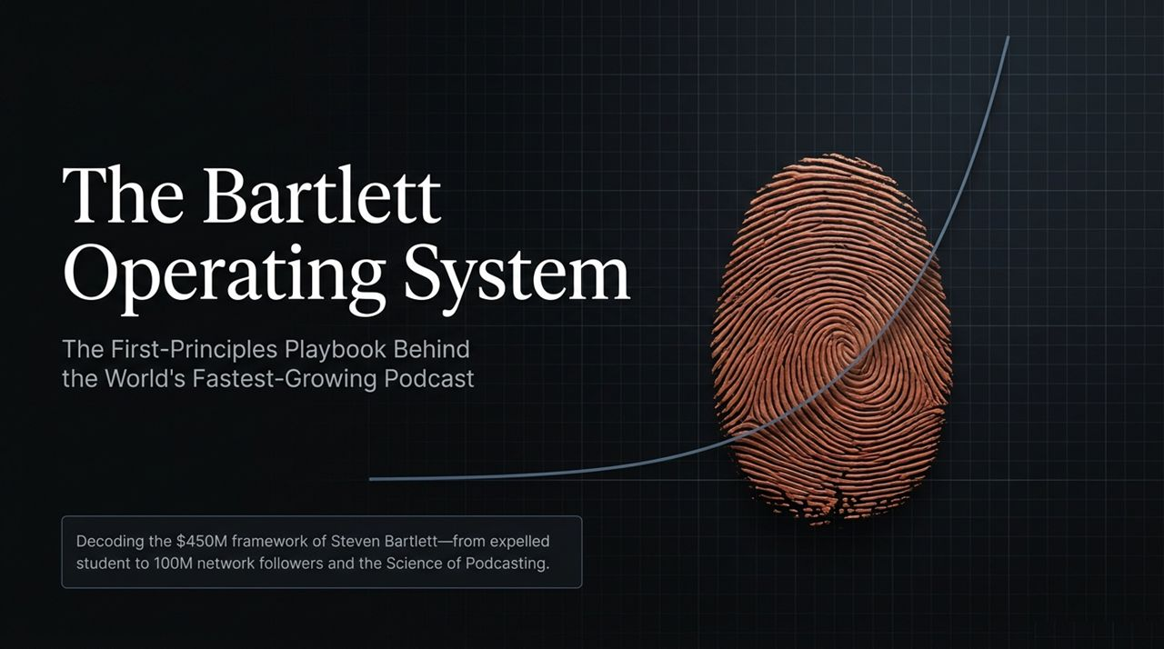
Notes:
Good morning/afternoon, everyone. Today, we are decoding "The Bartlett Operating System"—the underlying first-principles framework behind the world’s fastest-growing podcast and media ecosystem.
When people look at Steven Bartlett—from being a university dropout to building a $450M framework and reaching over 100 million network followers—they often assume he got lucky or stumbled into viral success. But if you look behind the scenes, nothing about this growth is accidental. It is entirely a scientific system based on rigorous execution, rapid experimentation, and human behavior.
Throughout this deck, we are moving away from surface-level tactics and diving into the core principles that drive unstoppable, compounding growth. By the end of this session, you won't just learn podcasting tactics—you will gain an operating system that can be applied to any modern business, media strategy, or leadership model. Let’s dive in.
Steven Bartlett REVEALS the Secret Behind the World’s Fastest Growing Podcast | PBD Podcast #861
https://www.youtube.com/watch?v=4Na_49oFbKY

Slide 2
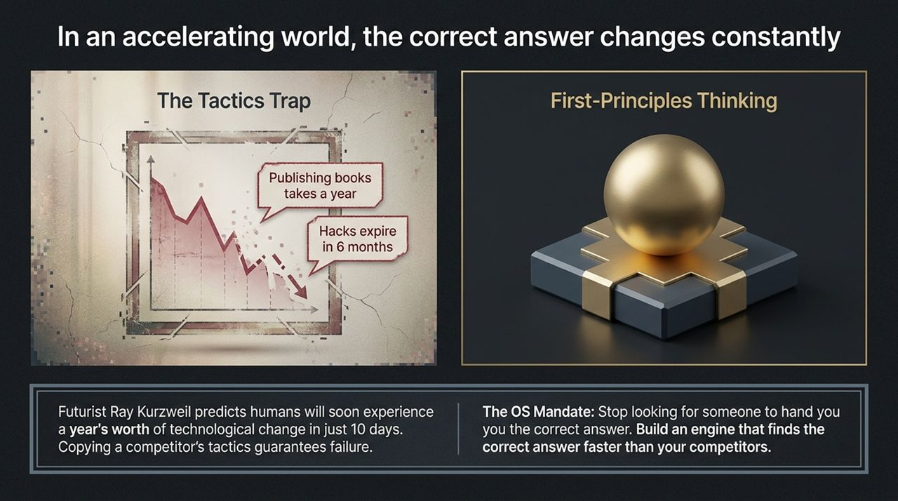
Notes:
Let’s start with the foundational problem most companies and creators face: The Tactics Trap.
In a world accelerating at breakneck speeds—where futurists like Ray Kurzweil predict we will soon experience a year's worth of technological change in just ten days—copying someone else's tactics is guaranteed failure. Why? Because tactics expire. A growth hack that works today will be obsolete in 6 months. Traditional processes, like spending a year to publish a book, are simply too slow for today's market velocity.
As Steven points out, if you rely strictly on strategies and tactics, you are constantly fighting yesterday's battles. But if you think in First Principles, the changing environment doesn't disorient you.
The mandate here is clear: Stop looking for someone to give you the "correct answer." Instead, build an internal engine that finds the correct answer faster than your competitors can.

Slide 3
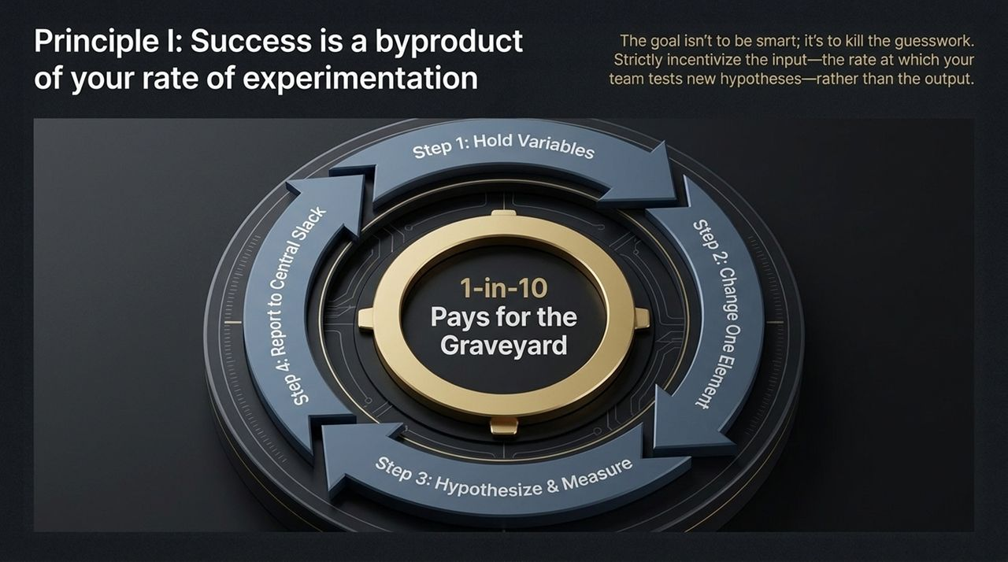
Notes:
Principle Number One: Success is a direct byproduct of your rate of experimentation.
Most teams waste months debating in boardrooms, trying to come up with the "smartest" or "perfect" idea. The Bartlett OS rejects this entirely. The goal is not to be smart; it’s to kill guesswork through empirical data.
Look at the 4-step experimental framework outlined here:
Hold Variables: Establish a clean baseline.
Change One Element: Isolate what you are testing—whether it's a headline, a thumbnail, or a 10-second opening hook.
Hypothesize & Measure: Set clear expectations before gathering real user data.
Report to Central Slack: Shared organizational learning.
Notice the graphic on the right: "1-in-10 Pays for the Graveyard." Out of ten experiments, nine might fail. But that one successful trial yields explosive returns that pay for all previous failures combined. Manage and incentivize your team based on input (the number of hypotheses tested per week), not just immediate output.

Slide 4
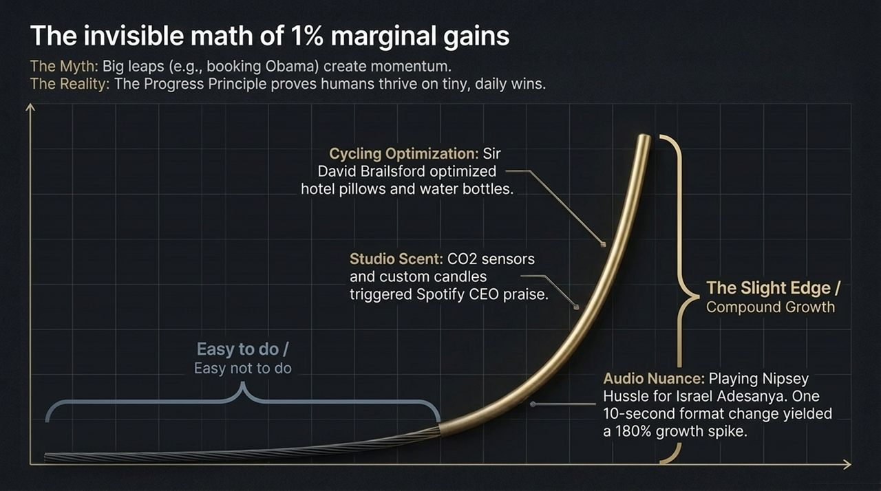
Notes:
There is a massive myth in business that momentum comes from huge, dramatic leaps—like booking a world-famous celebrity or launching a multi-million-dollar campaign.
The reality is governed by The Progress Principle: human beings and teams thrive on tiny, daily victories. This is the invisible math of 1% marginal gains. Small improvements, when stacked consistently over time, create unstoppable compound growth.
Let's look at three real-world examples of this in action:
Cycling Optimization: Sir David Brailsford transformed British Cycling by optimizing tiny details—down to bringing the team's custom hotel pillows on the road and refining water bottle shapes.
Studio Environment: In the Diary of a CEO studio, CO2 sensors are monitored and custom candles are lit. Spotify’s CEO praised the environment because the physical comfort directly impacts the conversational depth.
Audio & Format Nuance: Simply playing Nipsey Hussle’s music to set the mood for guest Israel Adesanya, or making a subtle 10-second format adjustment to the audio edit, yielded a 180% growth spike.
Never underestimate the compound impact of details that are "easy to do, but easy not to do."

Slide 5
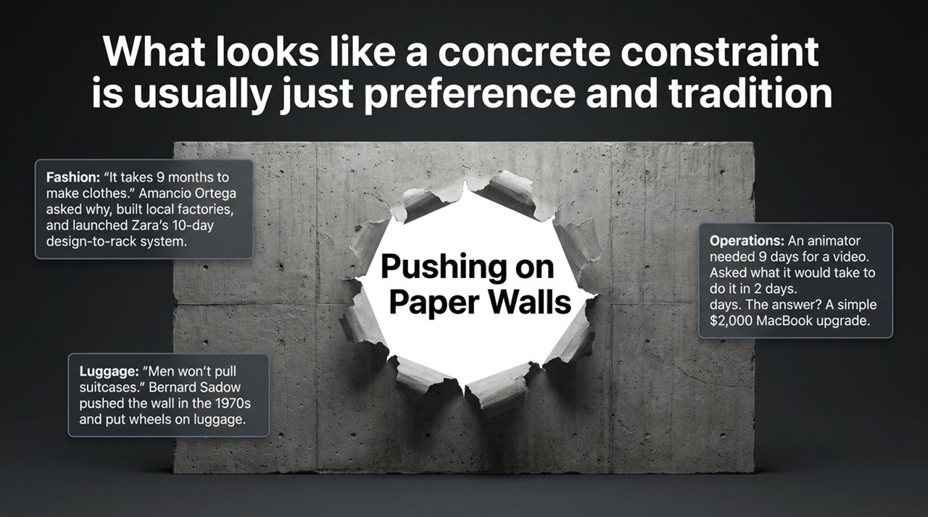
Notes:
One of the most dangerous blind spots in any industry is confusing tradition and preference with actual concrete constraints. We call these "Paper Walls." They look like solid barriers from a distance, but if you push on them, they collapse instantly.
Consider these three case studies:
Fashion (Zara): The fashion industry operated under the belief that making clothes took 9 months. Amancio Ortega questioned why, built localized supply chains, and established Zara's famous 10-day design-to-rack system.
Operations: A video animator claimed a clip would take 9 days. When asked, "What would it take to get this done in 2 days?" the roadblock wasn't talent or time—it was processing speed. A simple $2,000 MacBook upgrade reduced production time by 78%.
Luggage: For decades, standard protocol dictated that men carried luggage. Bernard Sadow pushed against that paper wall in the 1970s by putting wheels on suitcases, revolutionizing global travel.
Tomorrow, examine your own operations. Ask your team: Which of our bottlenecks are true physical laws, and which are just paper walls we've accepted out of habit?

Slide 6
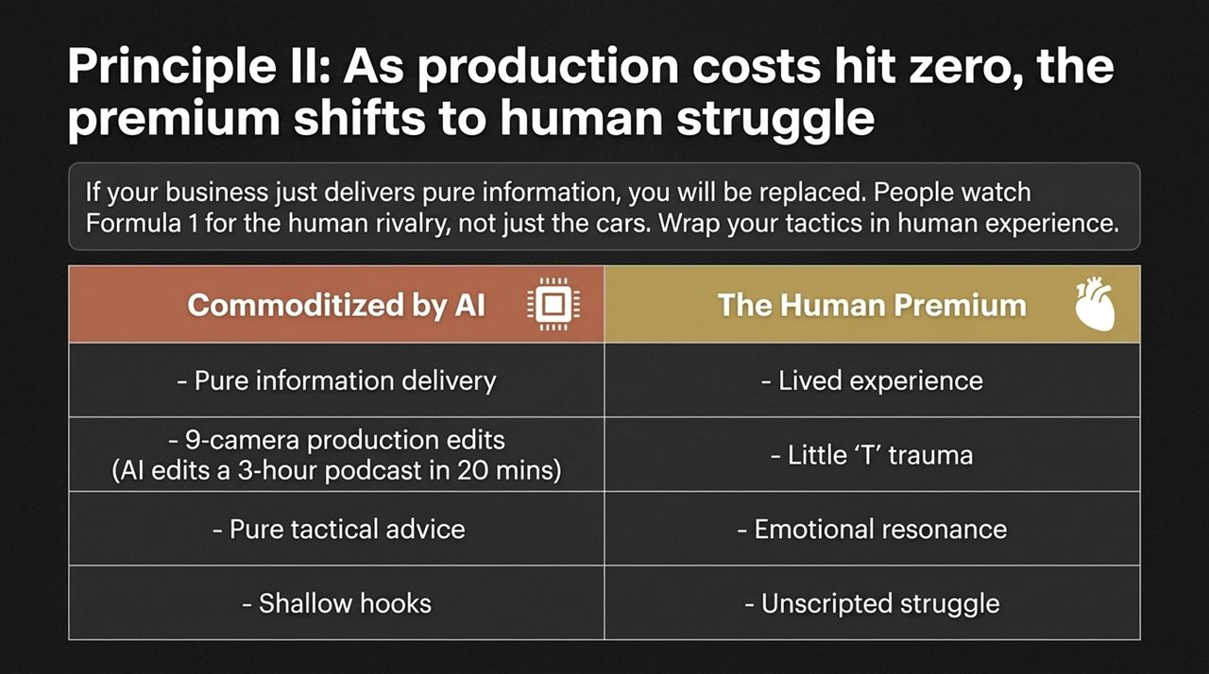
Notes:
We are living through an unprecedented inflection point: As the cost of content production hits zero, the premium shifts entirely to human struggle.
In the era of generative AI, pure information delivery is a commodity. AI can edit a 3-hour podcast down to clips in under 20 minutes. If your product or media simply delivers raw facts, shallow hooks, or generic advice, you are easily replaceable.
Why do millions of people watch Formula 1? Not just for the technological engineering of the cars, but for the human rivalry, tension, and stakes.
To build an enduring brand, you must wrap your business in the Human Premium:
Lived experience over dry facts.
Emotional resonance over cold, technical advice.
Unscripted struggle, vulnerability, and authenticity over polished corporate PR.

Slide 7
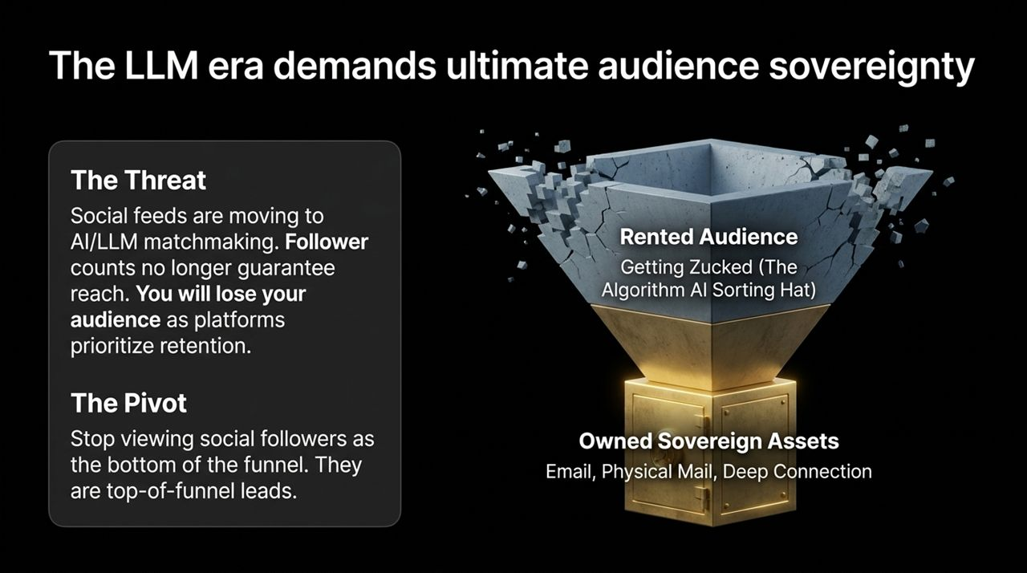
Notes:
This brings us to a major strategic risk in the digital landscape: The threat to rented audiences.
Social platforms are rapidly shifting away from social graphs to AI and LLM recommendation engines. Having 1 million followers no longer guarantees reach, because platforms prioritize session retention over publisher distribution. In media, this decay of organic reach—losing up to 50% year-over-year—is known as "Getting Zucked."
The Bartlett OS requires a crucial mindset pivot:
Stop viewing social media followers as the bottom of your funnel or an asset you own.
Treat social followers strictly as top-of-funnel leads.
Your primary objective must be converting rented algorithm traffic into Owned Sovereign Assets—such as email lists, direct physical touchpoints, and deep community relationships where no platform algorithm can stand between you and your audience.

Slide 8
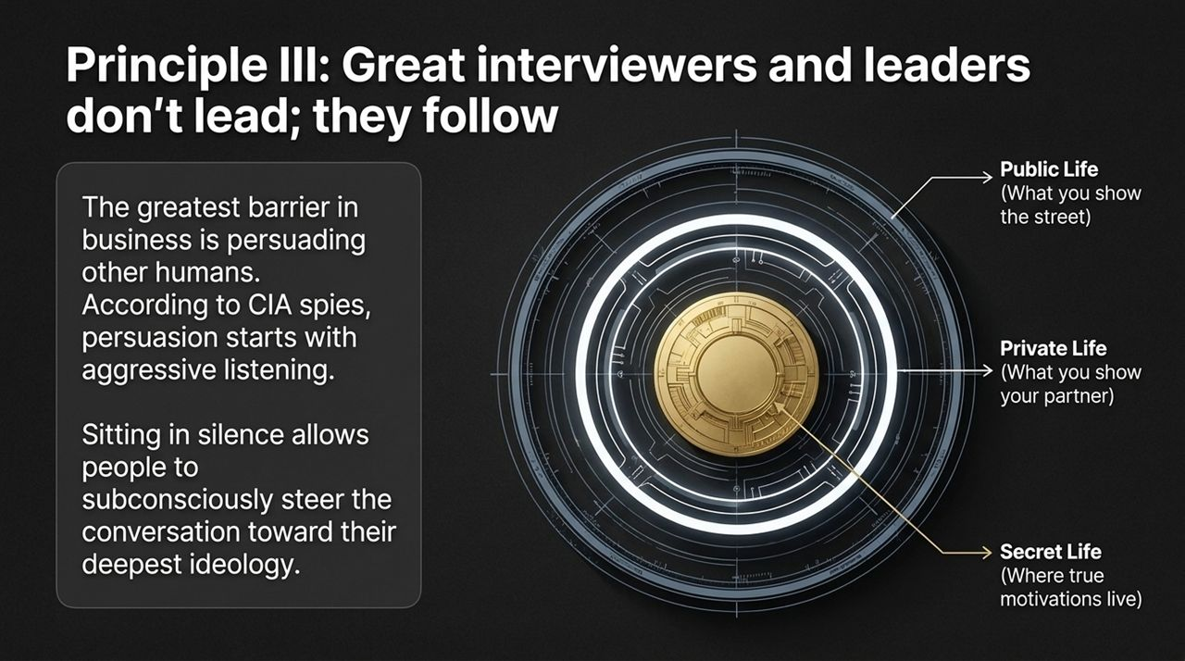
Notes:
Slide 8 illustrates the conceptual framework behind deep connection and effective interviewing: The Three Rings of Human Life.
To truly influence, lead, or draw out powerful stories, you have to understand where a person operates:
Public Life: This is the outer ring. It is what people show to the street, their resume, their social media persona, and their rehearsed soundbites.
Private Life: The middle ring. This is what people share only with close friends, family, or partners.
Secret Life: The gold core in the center. This is where true motivations, unresolved fears, inner chips on the shoulder, and core identity reside.
If you stay in the outer ring, you get superficial answers and generic engagements. Mastering communication requires navigating inward to the Secret Life.

Slide 9
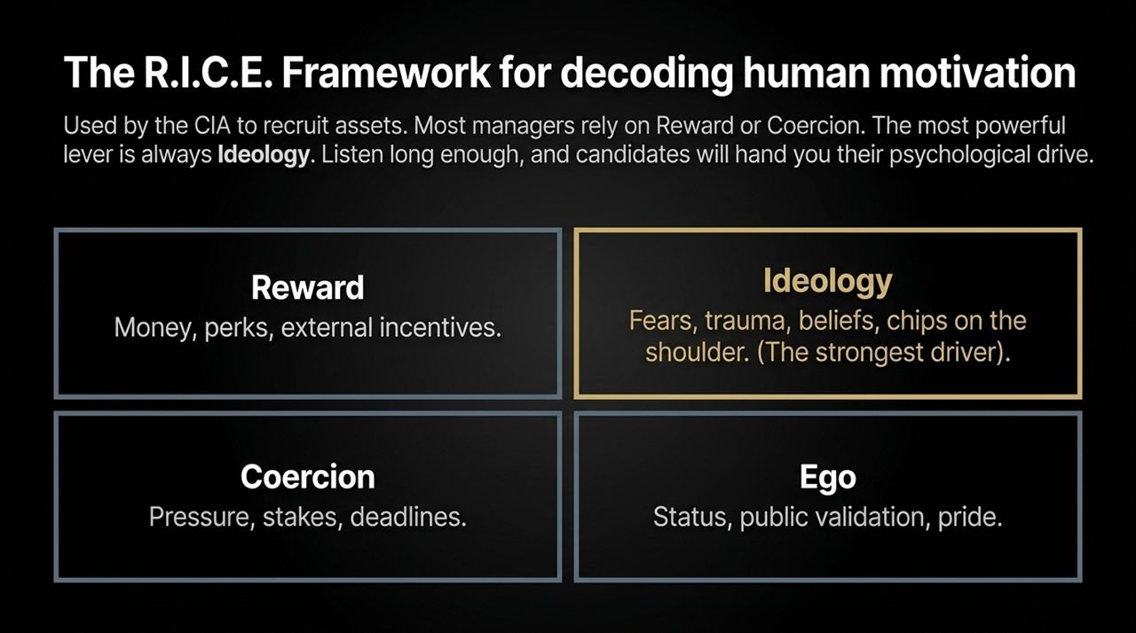
Notes:
Building on the previous slide, Principle III states: Great interviewers and leaders don't lead; they follow.
The biggest bottleneck in scaling any business or media company is persuading human beings. Drawing from techniques used by intelligence agencies to recruit assets, persuasion starts with aggressive listening and sitting comfortably in silence. When you allow quiet space in a conversation, people naturally steer toward their core values.
To decode human motivation, we use the R.I.C.E. Framework:
R – Reward: Cash, bonuses, and perks. (Important, but shallow).
I – Ideology: A person’s beliefs, inner convictions, and deeply held values. This is the single most powerful driver.
C – Coercion: Deadlines, pressure, and operational stakes.
E – Ego: Public status, prestige, and pride.
Most conventional managers rely almost exclusively on Reward or Coercion. But top-tier leaders listen long enough to uncover an individual's Ideology, unlocking intrinsic drive.

Slide 10
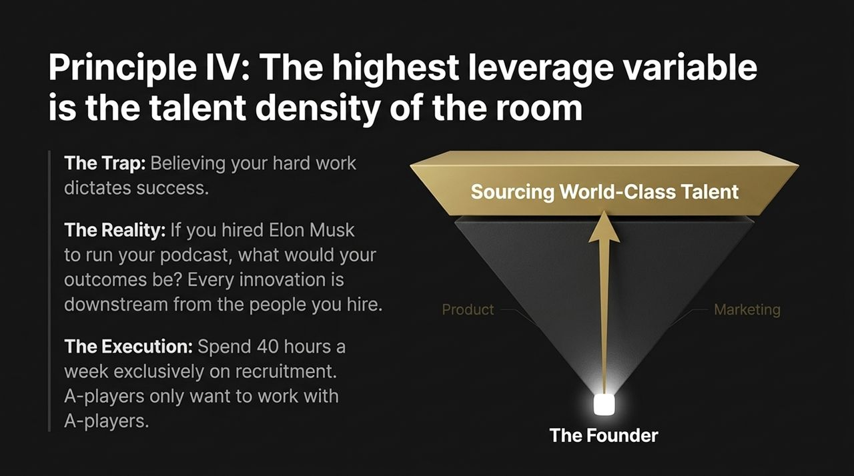
Notes:
Principle IV shifts focus inward to organizational design: The highest leverage variable in any business is the talent density of the room.
Many founders fall into the trap of believing that their individual hours and hard work determine the ultimate output of the company. But ask yourself this forcing question: If you hired Elon Musk or an absolute world-class expert to run your specific department tomorrow, how radically would your outcomes change?
Every operational breakthrough, creative output, and product feature is downstream from who you hire.
Because talent density dictates leverage, leaders should treat recruitment as primary work—spending upwards of 30 to 40 hours a week exclusively sourcing world-class talent. Exceptional A-players refuse to work with B or C players; keeping talent density ultra-high is your greatest retention tool.

Slide 11
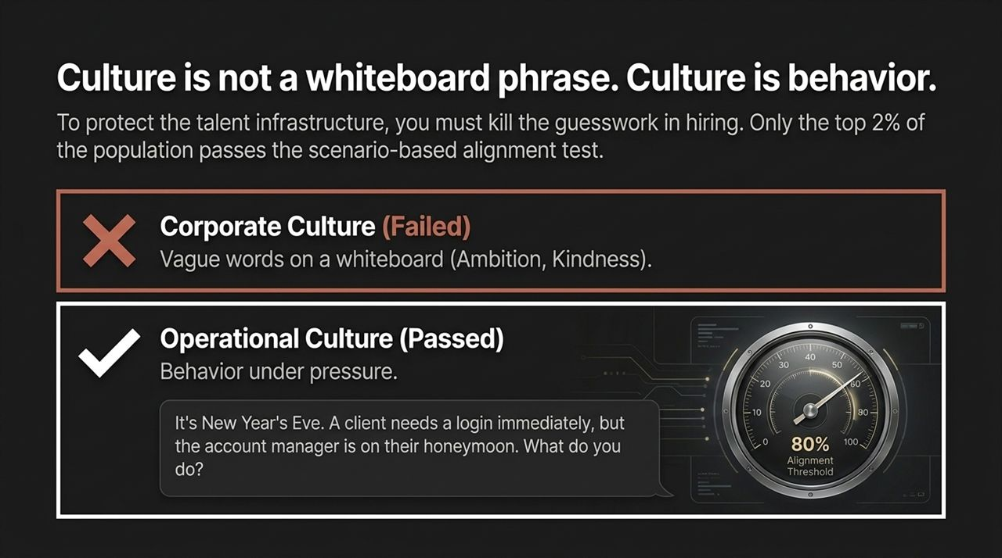
Notes:
Culture is not a set of inspiring values written on a office whiteboard or listed on a careers page. Culture is real-world behavior under pressure.
To safeguard talent infrastructure, you must remove subjectivity from hiring. At Bartlett’s organizations, candidates are put through scenario-based alignment assessments.
Look at the practical test shown on this slide:
"It's New Year's Eve. A key client urgently needs a platform login, but the designated account manager is currently away on their honeymoon. What do you do?"
This scenario instantly tests ownership, initiative, problem-solving, and respect for boundaries. By setting an 80%+ alignment threshold on scenario-based tests, only the top 2% of candidates pass. That is how you institutionalize high performance.

Slide 12
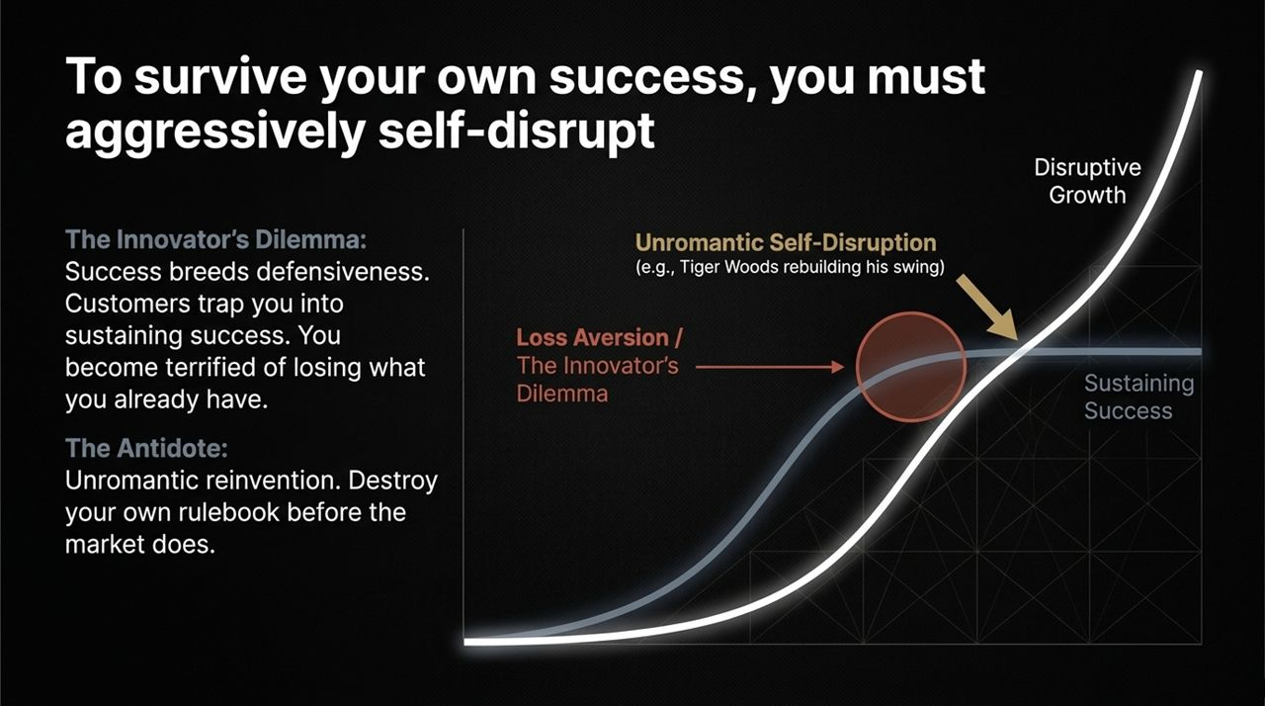
Notes:
Success contains the seeds of its own destruction. This concept, drawn from Clayton Christensen's The Innovator's Dilemma, is illustrated by the S-curve on Slide 12.
When a company experiences disruptive growth and hits a peak of success, loss aversion sets in. Leaders become defensive, protective, and afraid to risk what they have built. They focus on sustaining legacy systems while new, agile competitors emerge.
The antidote is Unromantic Self-Disruption.
Think of Tiger Woods at the height of his career completely rebuilding his golf swing to reach a higher performance ceiling. You must be willing to dismantle your own successful playbooks, formats, and products before the market forces you to.

Slide 13
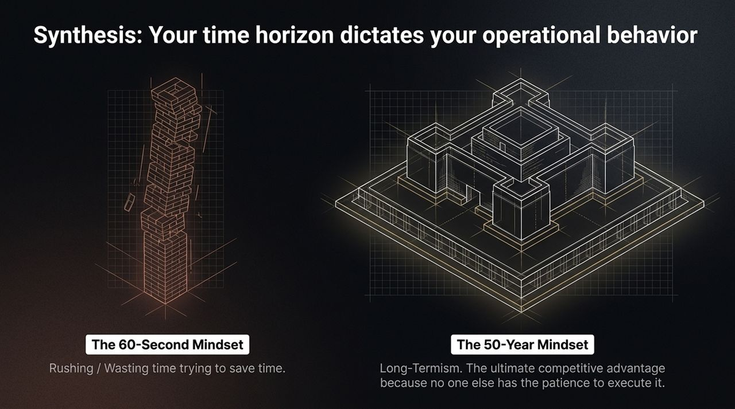
Notes:
On the left, you see a Jenga Tower architecture—representing businesses built on quick hacks, single-platform dependencies, high staff turnover, and fragile operational shortcuts. It might look tall temporarily, but as soon as a key piece is pulled out or an algorithm shifts, the entire structure collapses.
On the right, you see a Fortified Fortress. This represents an organization built on first-principles thinking, owned audience assets, high talent density, and clear operational frameworks. It is designed to withstand market volatility and platform shifts.

Slide 14
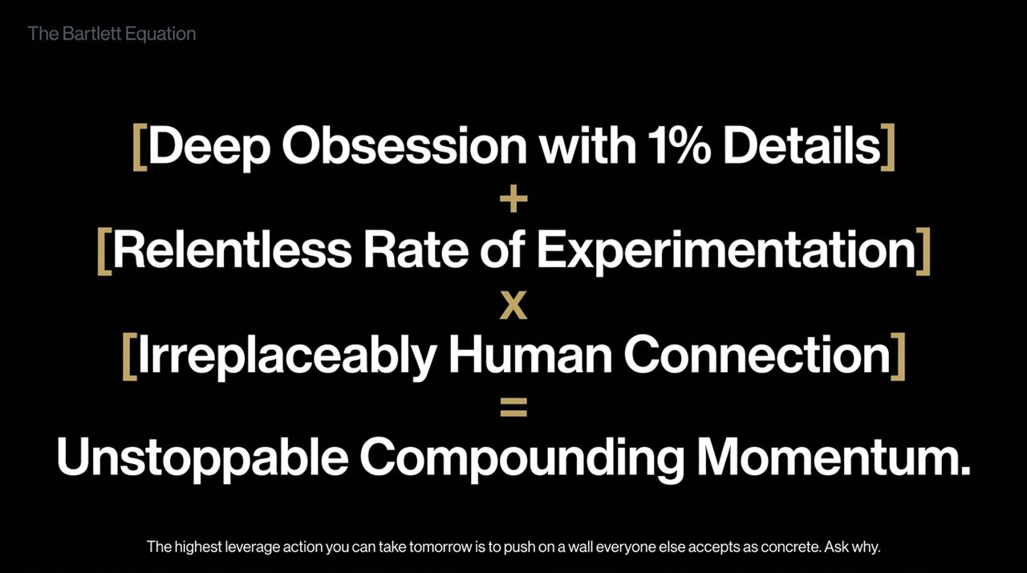
Notes:
Your operational behavior is ultimately dictated by your time horizon:
The 60-Second Mindset: Constant rushing, cutting corners, and losing time long-term by trying to save minutes short-term.
The 50-Year Mindset: Long-term compounding thinking. This is an unbeatable moat because almost no competitor has the patience to execute against a multi-decade timeline.
This brings us to The Bartlett Equation:
$$\left[\text{Deep} \text{Obsession} \text{with}\text{ 1\% }\text{Details}\right]+\left[\text{Relentless} \text{Rate} \text{of} \text{Experimentation}\right]×\left[\text{Irreplaceably} \text{Human} \text{Connection}\right]=Unstoppable Compounding Momentum$$

Slide 15
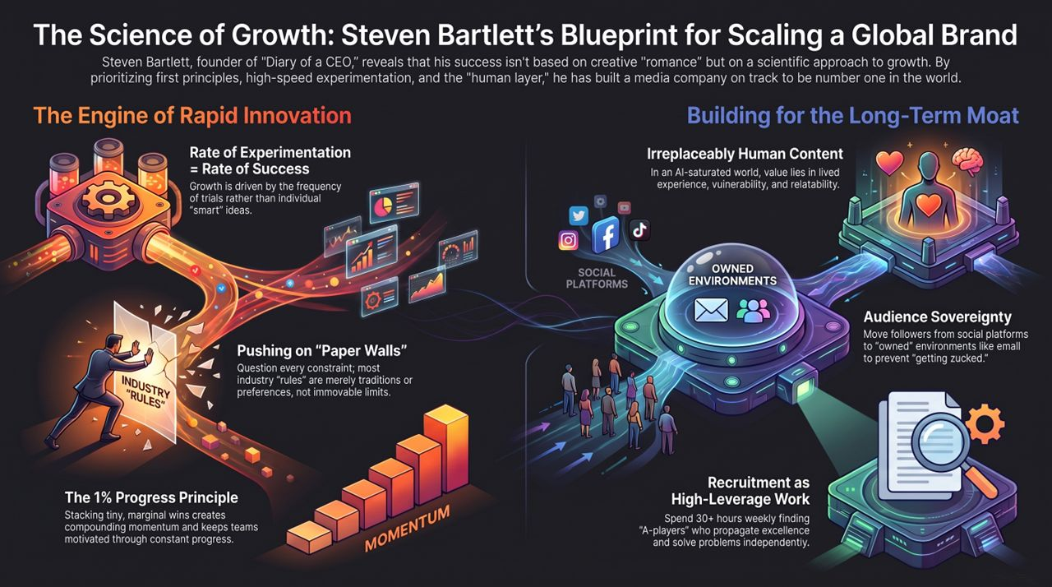
Notes:
To summarize our entire journey across Slides 1 through 15, let's review the Science of Growth Blueprint:
First Principles over Romance: Treat media and business as a scientific endeavor rather than a series of emotional guesses.
Speed of Trials: Maximize the frequency of your team's experiments to discover winning strategies.
Pushing Paper Walls: Relentlessly question industry rules and overcome artificial limits.
Human Layer: Double down on vulnerability, storytelling, and human experience in an AI-driven environment.
Talent Density & Owned Media: Dedicate maximum energy to recruiting elite talent and converting rented audiences into owned ecosystems.
Take this playbook, audit your current operations, and start pushing on the paper walls in your industry today. Thank you.
Steven Bartlett REVEALS the Secret Behind the World’s Fastest Growing Podcast | PBD Podcast #861
https://www.youtube.com/watch?v=4Na_49oFbKY

